Slide 1


Interactive Plan Explicability in Human-Robot Teaming
Mehrdad Zakershahrak, Akshay Sonawane, Ze Gong and Yu Zhang
CIDSE, Arizona State University
Cooperative Robotic Systems (CRS) Lab

Slide 2


Human-Robot Teaming
Effective teaming:
Situation awareness
Shared mental model
Direct and indirect interaction
Proactive actions
Robot
Human
Cooperative Robotic Systems (CRS) Lab

Slide 3




Robot needs to estimate human’s expectation
Robot need to estimate how the human would interpret its plan.
interaction
Cooperative Robotic Systems (CRS) Lab

Slide 4


Plan Explicability - Formulation
The explicability of a plan is correlated with a mapping of high-level tasks (as interpreted by humans) to the actions performed by the robot.
interaction
Cooperative Robotic Systems (CRS) Lab

Slide 5











Plan Explicability - Metric
Given a robot plan π in M_{R}, The explicability score of π is computed based on L_{π}.
inexplicable
Cooperative Robotic Systems (CRS) Lab

Slide 6


Interactive Plan Explicability
Interactive teaming setting instead of the human solely being an observer.
interaction
Cooperative Robotic Systems (CRS) Lab

Slide 7

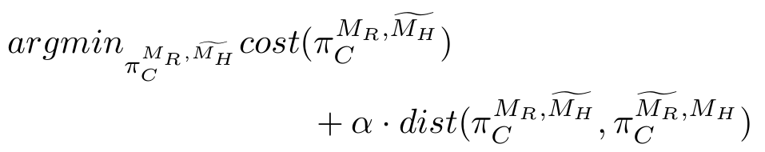


Interactive Plan Explicability
Composite plan:
Problem formulation:
: composite plan generated by the robot.
interaction
: composite plan that assumed to be expected by the human.
Cooperative Robotic Systems (CRS) Lab

Slide 8









Interactive Plan Explicability - labeling process
Cooperative Robotic Systems (CRS) Lab

Slide 9
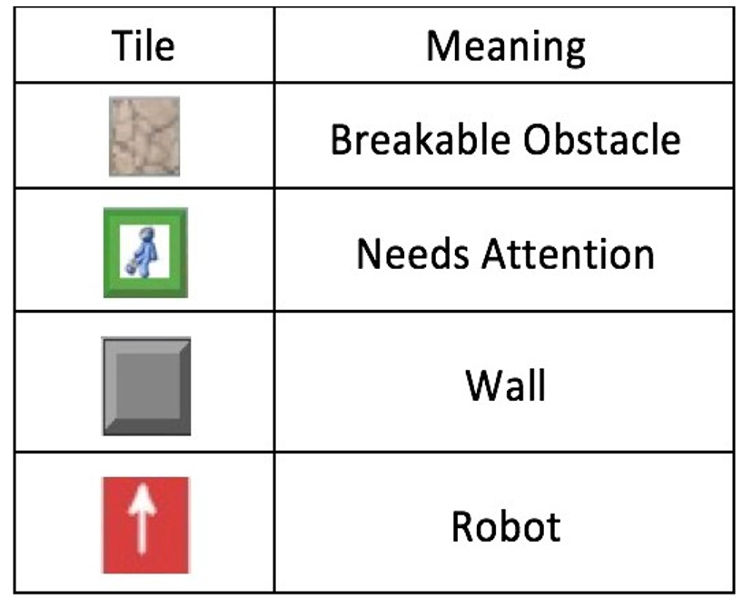
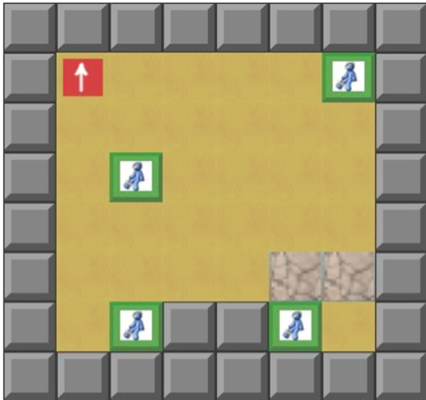
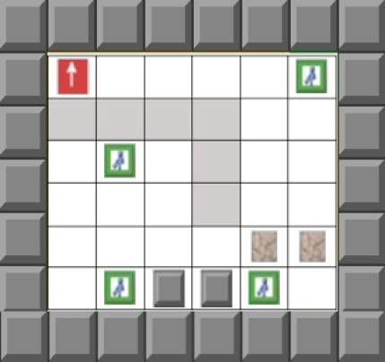
Experimental Scenario
Simulated first-response domain
Robot’s task: provide help to the marked locations.
Human’s task: help the robot by providing high-level guidance as to which marked location to visit next.
Team Goal: search all the marked locations as fast as possible.
Some paths may be blocked due to the disaster that the human may not know about
thus the robot might not take the expected paths of the human.
Human’s view
Robot’s view
Cooperative Robotic Systems (CRS) Lab

Slide 10
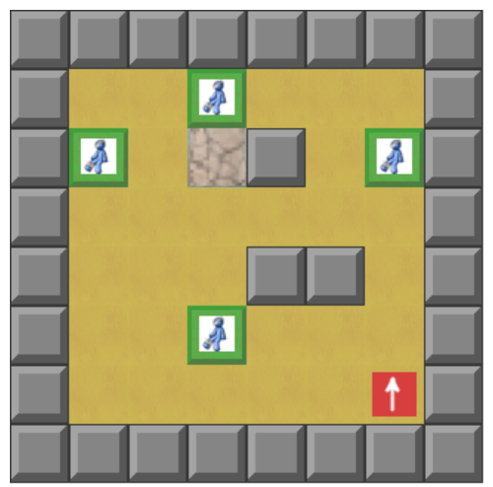
Data Collection
Participants provide high-level guidance and evaluate the robot’s behaviors.
Participant can change the target at any time.
Answers positively, explicable; otherwise, inexplicable.
Cooperative Robotic Systems (CRS) Lab

Slide 11
Results
Comparison of interactive plan explicability for test scenarios
Plan Type | Interactive Plan Explicability
Interactive Explicable Plan | 0.820
Optimal Plan | 0.672
Human Plan | 0.811
Using the IPE measure, the result shows that our planner can generate plans which are comparable to the plans created by actual human subjects.
Cooperative Robotic Systems (CRS) Lab

Slide 12
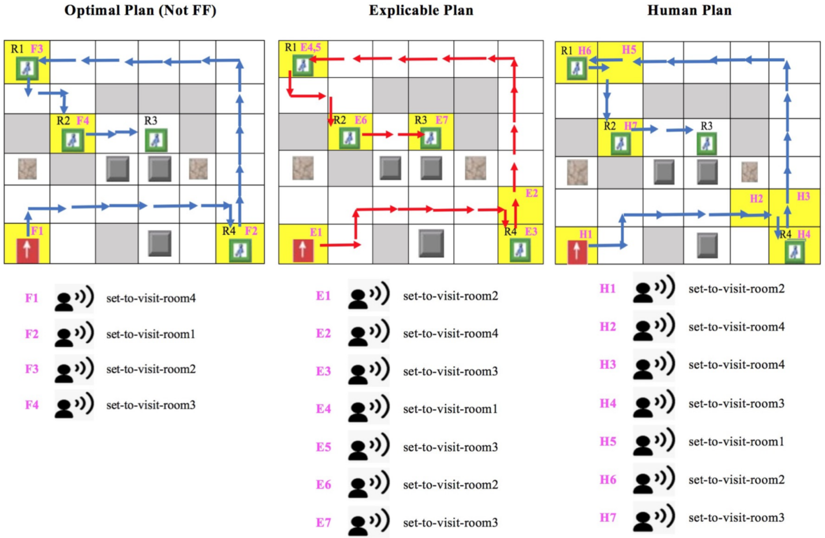

Slide 13
Conclusion
We created a general way of generating explicable plans for Human-Robot teams assuming that human is an active player.
Design a first-response domain where the human can interact with robot teammate.
The results imply that the plans generated using Interactive Plan Explicability metric may be better expected by the human.
Cooperative Robotic Systems (CRS) Lab

